Slide 1
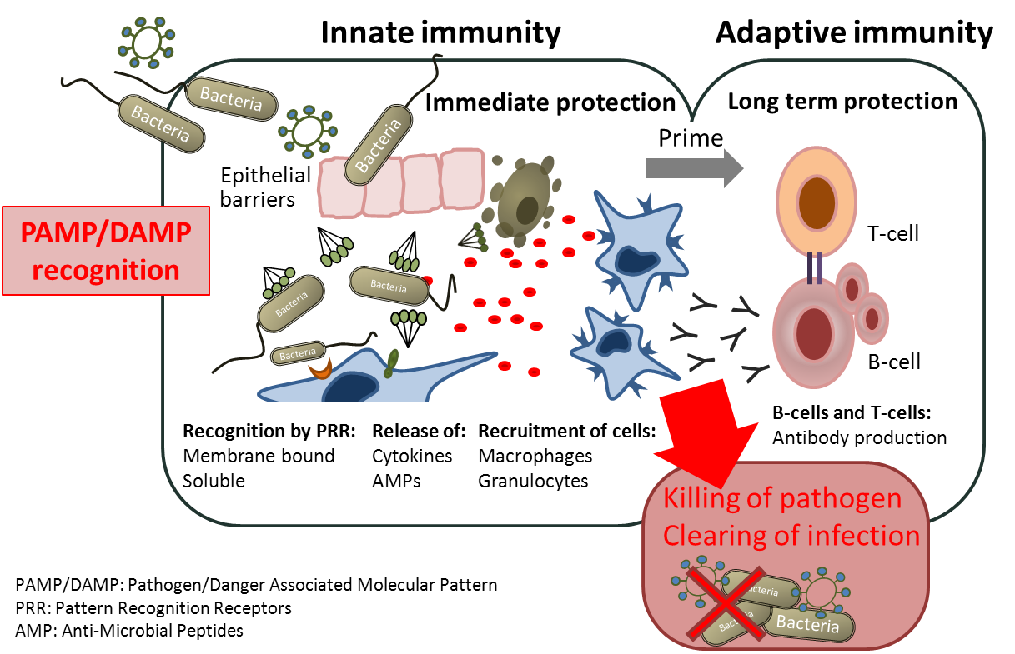
Innate Immunity -First Line of Host Defence
Lea Munthe-Fog

Slide 2
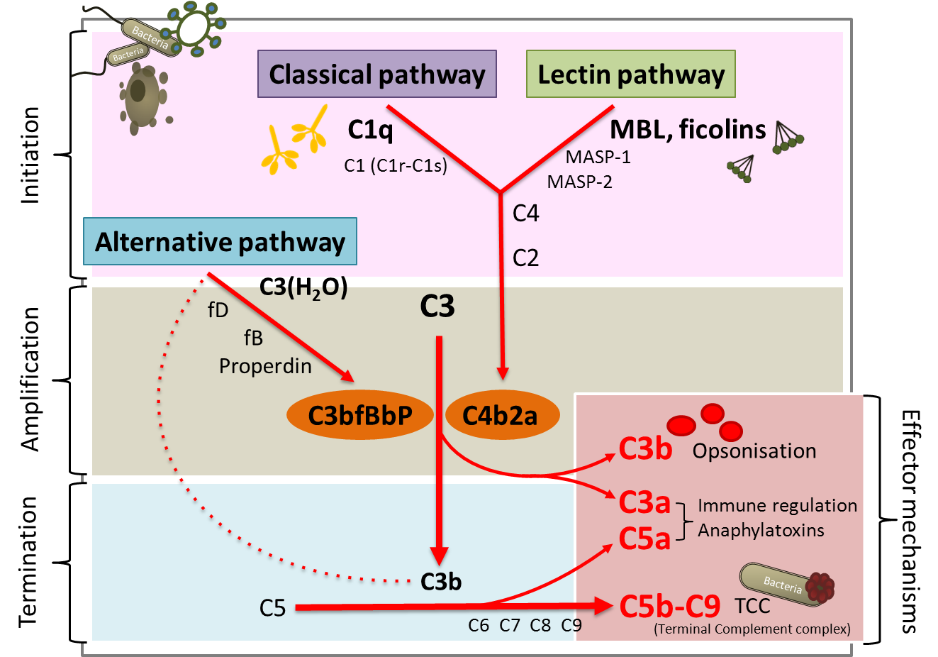
The Complement System is Activated by PAMPs/DAMPS
Lea Munthe-Fog

Slide 3
Recognition of PAMPs/DAMPs by Complement Receptors (CRs)
Phagocytosis
Cell type
Macrophages Chemotaxis Granulocytes Cytokine storm
Mastcells Degranulation
T-Cells (?)
Lea Munthe-Fog

Slide 4
Recognition of PAMPs/DAMPs by Toll-Like Receptors (TLRs)
Bacteria
Bacteria
Lea Munthe-Fog

Slide 5
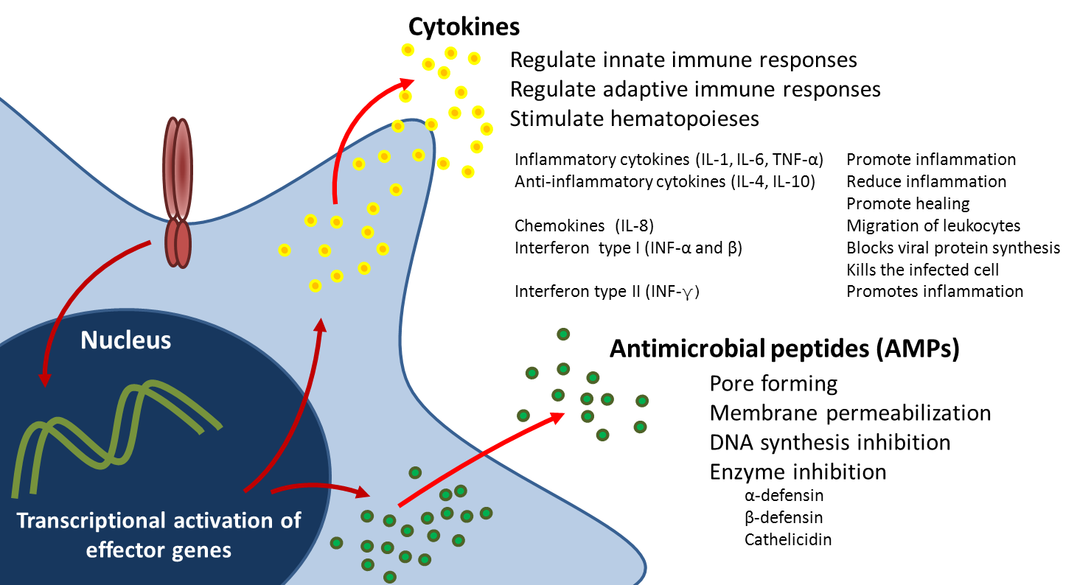
Cytokines and Anti-microbial Peptides are Released in Response to PAMPs/DAMPs
Bacteria
Bacteria
Lea Munthe-Fog

